Slide 1

Lending Club Loan Data Prediction & Analysis
Data Science Engineering Methods and Tools
Group 5: Aditya Salunkhe, Sahil Bagwan,
Shruti Kasar, Sumedh Telang

Slide 2

INTRODUCTION
Lending Club is an American based peer-to-peer lending company which has helped over 2.5+ million customer in a span of over 13 years (2005 -2018) through personal, auto refinancing, business and medical financing loans.
Investors lend money directly to borrowers via the online platform. Lending Club offers loans up to $40,000 across 2 loan terms (36/60 months).
Loans are issued according to various grades, corresponding to different interest rates.

Slide 3

WHY LOAN ANALYSIS?
The loan industry of the United States has gone through several distinct phases of evolution that has made it as the largest and most complex market all over the world.
Applying Loan Analysis will help determine if loans are made on feasible terms and if potential borrowers can and are willing to pay back the loan.
It will also help in assessing the skills and financial knowledge of the borrower to determine the level of risk involved.
Hence this project will help us understand the important factors in this everlasting loan scene.

Slide 4

OBJECTIVES
Identify if the Lending club loan will be charged off.
Analyze factors that affect the interest rate, credit grade and predict the interest rate.
Should one invest with Lending Club?
Identify potential defaulters.

Slide 5


DATA SOURCES:
Lending Loan Dataset – Kaggle
Loan.csv
Browse Notes
SPECIFICATIONS:
Files Included:
Loan.csv
LCDataDictionary.xlsx
Number of Columns: 145
Number of Rows: 421,097
Dataset Size – 1.11 GB
Type of Data – Text

Slide 6

METHODOLOGY
We intend to use to the following supervised ML algorithms to train the model for predictive analysis.
Logistic Regression
Naïve Bayes Classifier
Linear Regression
Random Forest
Gradient Boosting

Slide 7

THIS IS HOW WE STARTED
Data Cleaning, Analysis & Statistics
Removing columns containing more than 40% of NULL values
Cleaning data not containing uniform values
Elimination of current loan status as it doesn't help in predictions
Removing NaN values from the dataset
Converting data frame of emp_length into integer format by removing inconsistencies
Removing last 2 rows with no data
Finding correlation for the entire dataset and elimination of features with same meaning to avoid duplicity

Slide 8
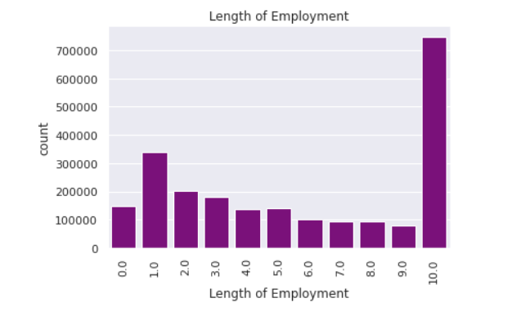
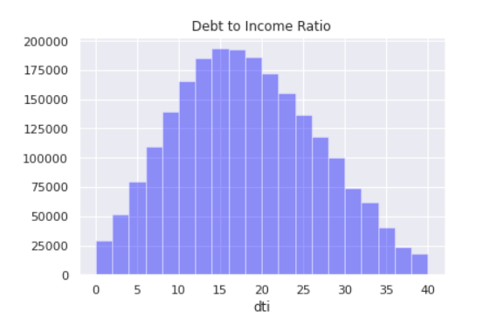
Perform Exploratory Analysis to get relevant data
More loans were disbursed to individuals who have worked 10 or more years.

Slide 9
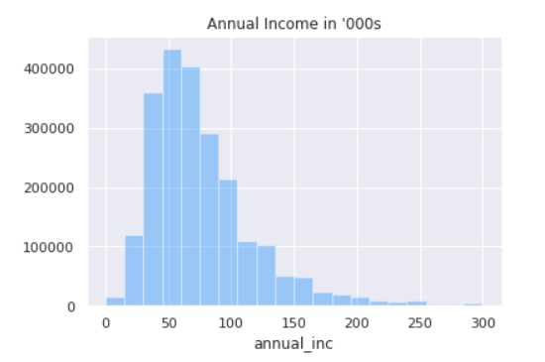
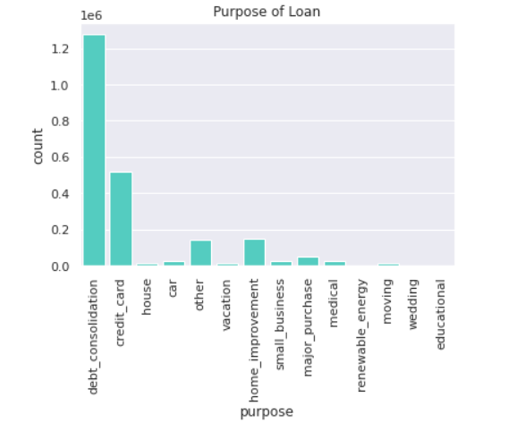
Annual Income of people in the 000’s & Purpose of the loan taken

Slide 10
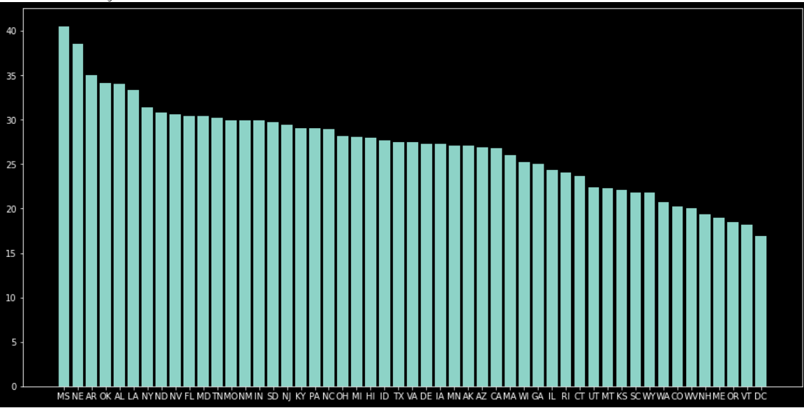
State wise bad loan with Mississippi, Nebraska and Arkansas being the least safe

Slide 11
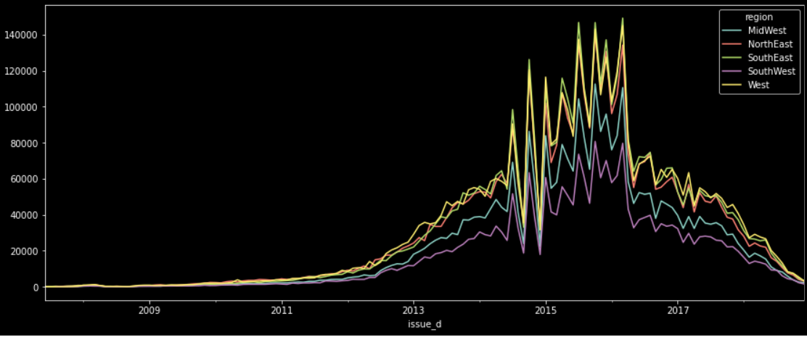
Region wise loan distribution

Slide 12
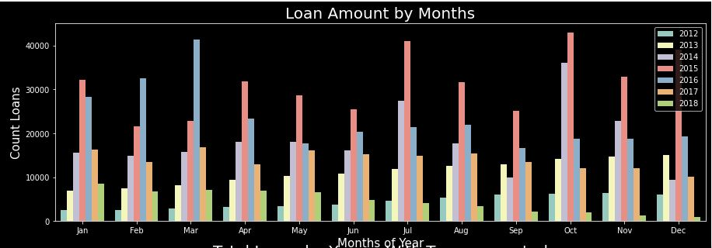
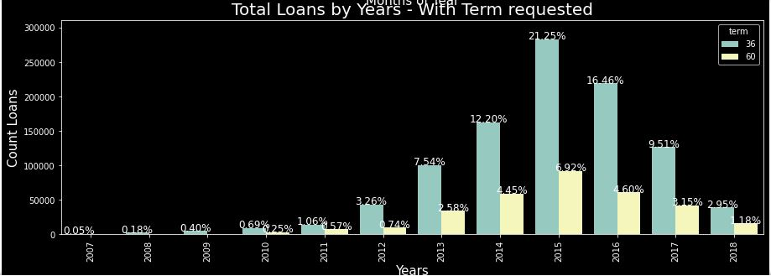

Slide 13
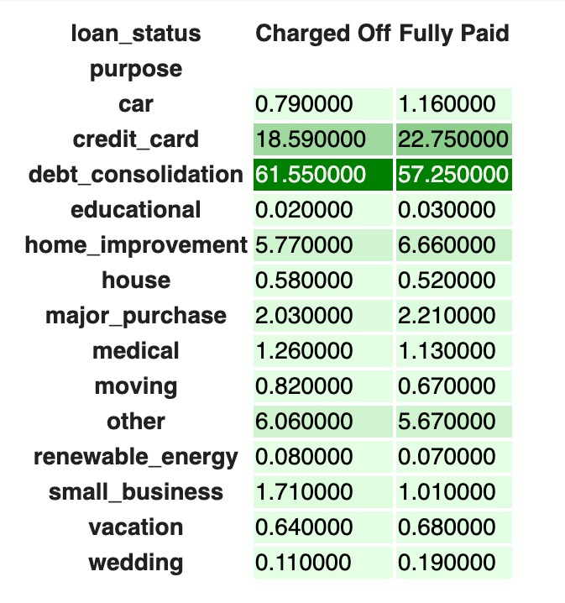

Slide 14
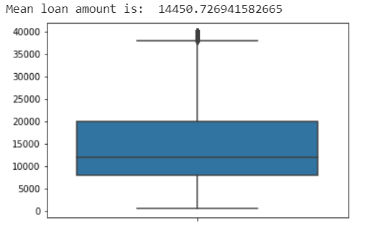
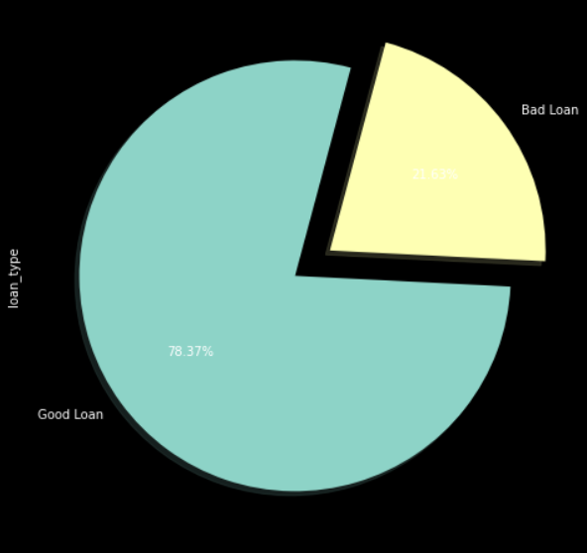
Average loan amount Good Loans vs Bad Loans Comparison

Slide 15
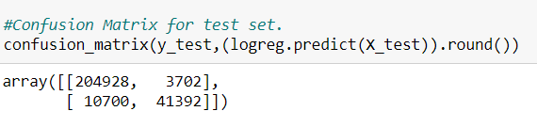
THE ALGORITHMS
Logistic Regression:
Used when the dependent variable is binary.
We used to describe data and to explain the relationship between one dependent binary variable and one or more nominal, ordinal, interval or ratio-level independent variables.
The accuracy for the dataset using Logistic regression for which the loan will be waived off is 0.94476.

Slide 16
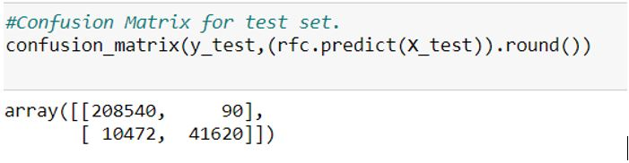
2. Random Forest Algorithm:
Used for both classification as well as regression.
We Used it to create decision trees on data samples and then gets the prediction from each of them and finally selects the best solution by means of voting.
The accuracy for the dataset using Random Forest algorithm for which the loan will be waived off is 0.95949.

Slide 17
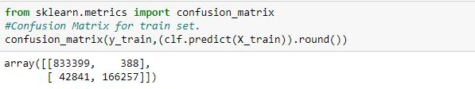
3. Gradient Boosting Classifier:
Gradient boosting is a machine learning technique for regression and classification problems, which produces a prediction model in the form of an ensemble of weak prediction models, typically decision trees.
Boosting is a method of converting weak learners into strong learners. In boosting, each new tree is a fit on a modified version of the original data set.
The accuracy for the dataset using Gradient Boosting Classifier for which the loan will be waived off is 0.95701.

Slide 18
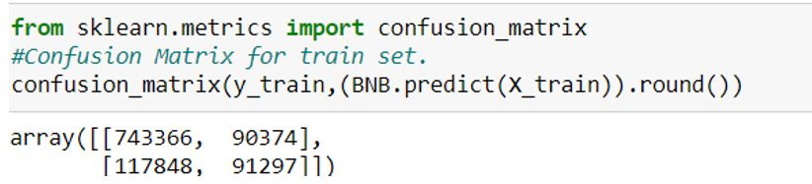
4. Naïve Bayes Classifier:
A naive Bayes classifier is an algorithm that uses Bayes' theorem to classify objects.
The accuracy for the dataset using Naïve Bayes algorithm for which the loan will be waived off is 0.80001.
5. Linear Regression:
Linear regression is a linear approach to modeling the relationship between a scalar response (or dependent variable) and one or more explanatory variables (or independent variables).
The accuracy for the dataset using Linear Regression algorithm for which the loan will be waived off is 0.56918 .

Slide 19
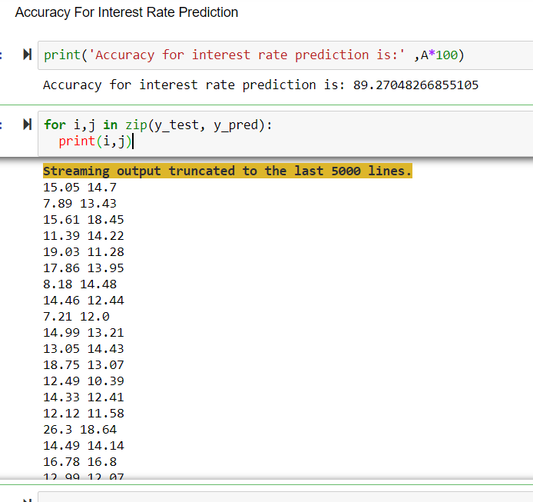
INTEREST RATE PREDICTION
Using Gradient Boosting Classifier, we predict the interest rate for a loan based on the given factors like loan amount, annual income, debt to income ratio, employment length, total current balance, term etc.

Slide 20
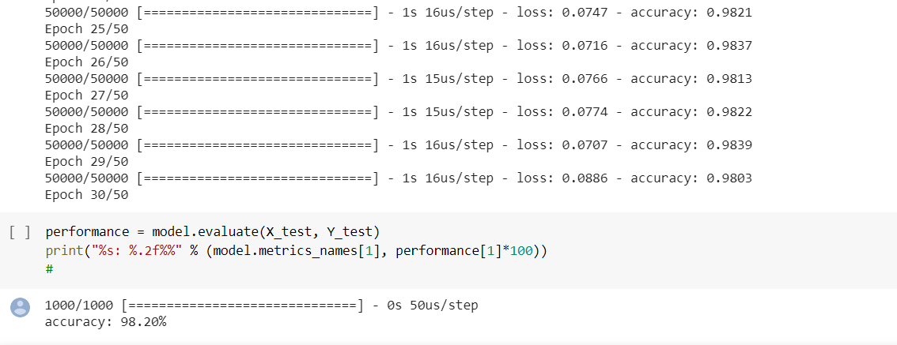
DEEP LEARNING
Deep learning is a machine learning technique that teaches computers to do what comes naturally to humans: learn by example. We’re using a 3-layered dense neural network for classification of the potential loan defaulters by training the model for 50 epochs.

Slide 21

RESULT AND ANALYSIS
Loan Waive off Accuracy:
Logistic regression - 0.94476 Random Forest Algorithm- 0.95949 (The best of all) Gradient Boosting Classifier - 0.95701 Naïve Bayes algorithm - 0.80001 Linear Regression – 0.56918
Interest Rate Prediction:
Accuracy for interest rate prediction is 89.27 using Gradient Boost Classifier.
Potential Loan Defaulter Prediction:
Accuracy for the forecasting of the potential loan defaulters based on their current loan status using neural networks is 98.2%

Slide 22

LIMITATIONS
Data only from 2005-2018
Data has not been tested during periods of financial crisis, as interest rates and default rates would likely increase during those periods.
Credit scores were not given for 2018’s data. This would likely be another feature that could affect the model.

Slide 23
CONCLUSION
Lending Club’s data is a great source of information on personal credit. Additionally, this data set is bound to grow exponentially over the next years.
In this project we have tried to predict the loan waive off accuracy by using different algorithms and have got the result to a 95% accuracy.
With the interest rate prediction, we can easily predict what the interest rate would be for an individual loan.
Analyzing the loan data, Lending Club had 78% of the loans that were in good standing with respect to the loan paid, installments and waive off accuracy.
Hence one can say that it is worth investing with Lending Club.

Slide 24
REFERENCES
https://www.kaggle.com/wendykan/lending-club-loan-data#loan.csv
https://www.edureka.co/blog/logistic-regression-in-python/
https://geekflare.com/choosing-ml-algorithms/

Slide 25
THANK YOU!

